Slide 1
Decision Properties of Regular Languages
General Discussion of “Properties”
The Pumping Lemma
Membership, Emptiness, Etc.

Slide 2
Properties of Language Classes
A language class is a set of languages.
We have one example: the regular languages.
We’ll see many more in this class.
Language classes have two important kinds of properties:
Decision properties.
Closure properties.

Slide 3
Representation of Languages
Representations can be formal or informal.
Example (formal): represent a language by a Regular Expression or DFA defining it.
Example: (informal): a logical or prose statement about its strings:
{0^{n}1^{n} | n is a nonnegative integer}
“The set of strings consisting of some number of 0’s followed by the same number of 1’s.”

Slide 4
Decision Properties
A decision property for a class of languages is an algorithm that takes a formal description of a language (e.g., a DFA) and tells whether or not some property holds.
Example: Is language L empty?

Slide 5
Subtle Point: Representation Matters
You might imagine that the language is described informally, so if my description is “the empty language” then yes, otherwise no.
But the representation is a DFA (or a RE that you will convert to a DFA).
Can you tell if L(A) = ∅ for DFA A?

Slide 6
Why Decision Properties?
When we talked about protocols represented as DFA’s, we noted that important properties of a good protocol were related to the language of the DFA.
Example: “Does the protocol terminate?” = “Is the language finite?”

Slide 7
Why Decision Properties – (2)
We might want a “smallest” representation for a language, e.g., a minimum-state DFA or a shortest RE.
If you can’t decide “Are these two languages the same?”
I.e., do two DFA’s define the same language?
You can’t find a “smallest.”

Slide 8
Closure Properties
A closure property of a language class says that given languages in the class, an operator (e.g., union) produces another language in the same class.
Example: the regular languages are obviously closed under union, concatenation, and (Kleene) closure.
Use the RE representation of languages.

Slide 9
Why Closure Properties?
Helps construct representations.
Helps show (informally described) languages not to be in the class.

Slide 10
Example: Use of Closure Property
Assume we can prove L₁ = {0^{n}1^{n} | n > 0} is not a regular language (see pumping lemma later)
L₂ = the set of strings with an equal number of 0’s and 1’s isn’t either, but that fact is trickier to prove.
Regular languages are closed under ∩.
If L₂ were regular, then L₂ ∩L(0*1*) = L₁ would be, but it isn’t.

Slide 11
The Membership Question
Our first decision property is the question: “is string w in the regular language L?”
Assume L is represented by a DFA A.
Simulate the action of A on the sequence of input symbols forming w.

Slide 12
Example: Testing Membership
0 1 0 1 1
Next
symbol
0
0,1
1
1
A
B
C
Start
0
Current
state

Slide 13
Example: Testing Membership
0 1 0 1 1
Next
symbol
0
0,1
1
1
A
B
C
Start
0
Current
state

Slide 14
Example: Testing Membership
0 1 0 1 1
Next
symbol
0
0,1
1
1
A
B
C
Start
0
Current
state

Slide 15
Example: Testing Membership
0 1 0 1 1
Next
symbol
0
0,1
1
1
A
B
C
Start
0
Current
state

Slide 16
Example: Testing Membership
0 1 0 1 1
Next
symbol
0
0,1
1
1
A
B
C
Start
0
Current
state

Slide 17
Example: Testing Membership
0 1 0 1 1
Next
symbol
0
0,1
1
1
A
B
C
Start
0
Current
state

Slide 18
What if the Regular Language Is not Represented by a DFA?
There is a circle of conversions from one form to another:
RE
ε-NFA
DFA
NFA

Slide 19
The Emptiness Problem
Given a regular language, does the language contain any string at all.
Assume representation is DFA.
Construct the transition graph.
Compute the set of states reachable from the start state.
If any final state is reachable, then yes, else no.

Slide 20
The Infiniteness Problem
Is a given regular language infinite?
Start with a DFA for the language.
Key idea: if the DFA has n states, and the language contains any string of length n or more, then the language is infinite.
Otherwise, the language is surely finite.
Limited to strings of length n or less.

Slide 21
Proof of Key Idea
If an n-state DFA accepts a string w of length n or more, then there must be a state that appears twice on the path labeled w from the start state to a final state.
Because there are at least n+1 states along the path.

Slide 22
Proof – (2)
w = xyz
y
x
z
Then xy^{i}z is in the language for all i > 0.
Since y is not ε, we see an infinite
number of strings in L.

Slide 23
Infiniteness – Continued
We do not yet have an algorithm.
There are an infinite number of strings of length > n, and we can’t test them all.
Second key idea: if there is a string of length > n (= number of states) in L, then there is a string of length between n and 2n-1.

Slide 24
Proof of 2nd Key Idea
y
Remember:
We can choose y to be the first cycle on the path.
So |xy| < n; in particular, 1 < |y| < n.
Thus, if w is of length 2n or more, there is a shorter string in L that is still of length at least n.
Keep shortening to reach [n, 2n-1].
x
z

Slide 25
Completion of Infiniteness Algorithm
Test for membership all strings of length between n and 2n-1.
If any are accepted, then infinite, else finite.
A terrible algorithm.
Better: find cycles along the path from the start state to a final state.

Slide 26
Finding Cycles
Eliminate states not reachable from the start state.
Eliminate states that do not reach a final state.
Test if the remaining transition graph has any cycles.

Slide 27
The Pumping Lemma
The lemma is due to Yehoshua Bar-Hillel (1915 – 1975), an Israeli philosopher, mathematician and linguist.
We have, almost accidentally, proved a statement that is quite useful for showing certain languages are not regular.
Called the pumping lemma for regular languages.

Slide 28
Statement of the Pumping Lemma
Number of
states of
DFA for L
For every regular language L
There is an integer n, such that
For every string w in L of length > n
We can write w = xyz such that:
|xy| < n.
|y| > 0.
For all i > 0, xy^{i}z is in L.
Labels along
first cycle on
path labeled w

Slide 29
Example: Use of Pumping Lemma
We have claimed {0^{k}1^{k} | k > 1} is not a regular language.
Suppose it were. Then there would be an associated n for the pumping lemma.
Let w = 0^{n}1^{n}. We can write w = xyz, where x and y consist of 0’s, and y ≠ ε.
But then xyyz would be in L, and this string has more 0’s than 1’s.

Slide 30
Decision Property: Equivalence
Given regular languages L and M, is L = M?
Algorithm involves constructing the product DFA from DFA’s for L and M.
Let these DFA’s have sets of states Q and R, respectively.
Product DFA has set of states Q × R.
I.e., pairs [q, r] with q in Q, r in R.

Slide 31
Product DFA – Continued
Start state = [q₀, r₀] (the start states of the DFA’s for L, M).
Transitions: δ([q,r], a) = [δ_{L}(q,a), δ_{M}(r,a)]
δ_{L}, δ_{M} are the transition functions for the DFA’s of L, M.
That is, we simulate the two DFA’s in the two state components of the product DFA.

Slide 32
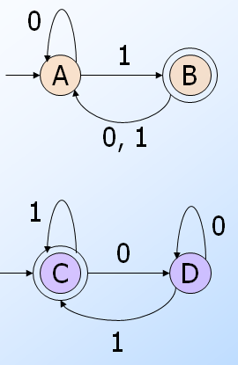
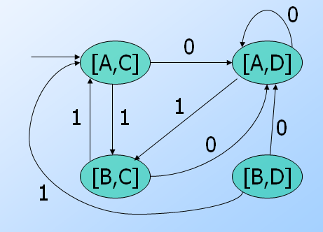
Example: Product DFA
Transitions: δ([q,r], a) =[δ_{L}(q,a), δ_{M}(r,a)]
Create the product DFA!

Slide 33
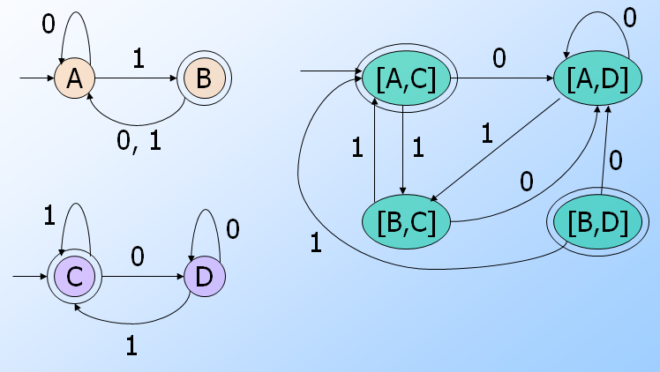
Equivalence Algorithm
Make the final states of the product DFA be those states [q, r] such that exactly one of q and r is a final state of its own DFA.
Thus, the product accepts w iff w is in exactly one of L and M.

Slide 34
Equivalence Algorithm – (2)
The product DFA’s language is empty iff L = M.
But we already have an algorithm to test whether the language of a DFA is empty.

Slide 35
Decision Property: Containment
Given regular languages L and M, is L ⊆ M?
Algorithm also uses the product automaton.
How do you define the final states [q, r] of the product so its language is empty iff L ⊆ M?
Note that L ⊆ M iff L-M= Ø
Answer: q is final; r is not.

Slide 36
Example: Containment
0
0
1
0
A
B
[A,C]
[A,D]
0, 1
1
1
1
0
0
1
[B,C]
[B,D]
0
1
0
C
D
Note: the only final state
is unreachable, so
containment holds.
1

Slide 37
The Minimum-State DFA for a Regular Language
In principle, since we can test for equivalence of DFA’s we can, given a DFA A find the DFA with the fewest states accepting L(A).
Test all smaller DFA’s for equivalence with A.
But that’s a terrible algorithm.

Slide 38
Efficient State Minimization
Construct a table with all pairs of states.
If you find a string that distinguishes two states (takes exactly one to an accepting state), mark that pair.
Algorithm is a recursion on the length of the shortest distinguishing string.

Slide 39
State Minimization – (2)
Basis: Mark a pair if exactly one is a final state.
Induction: mark [q, r] if there is some input symbol a such that [δ(q,a), δ(r,a)] is marked.
After no more marks are possible, the unmarked pairs are equivalent and can be merged into one state.

Slide 40
Transitivity of “Indistinguishable”
If state p is indistinguishable from q, and q is indistinguishable from r, then p is indistinguishable from r.
Proof: The outcome (accept or don’t) of p and q on input w is the same, and the outcome of q and r on w is the same, then likewise the outcome of p and r.

Slide 41
Constructing the Minimum-State DFA
Suppose q₁,…,q_{k} are indistinguishable states.
Replace them by one state q.
Then δ(q₁, a),…, δ(q_{k}, a) are all indistinguishable states.
Key point: otherwise, we should have marked at least one more pair.
Let δ(q, a) = the representative state for that group.

Slide 42
Example: State Minimization
r b
r b
A B C
B D E
C D F
D D G
E D G
F D C
G D G
{1}
{2,4} {5}
{2,4}
{2,4,6,8} {1,3,5,7}
Here it is
with more
convenient
state names
{5}
{2,4,6,8} {1,3,7,9}
{2,4,6,8}
{2,4,6,8} {1,3,5,7,9}
{1,3,5,7}
{2,4,6,8} {1,3,5,7,9}
* {1,3,7,9}
{2,4,6,8} {5}
*
* {1,3,5,7,9}
{2,4,6,8} {1,3,5,7,9}
*
Remember this DFA? It was constructed for the
chessboard NFA by the subset construction.

Slide 43
Example – Continued
r b
A B C
B D E
C D F
D D G
E D G
F D C
G D G
G F E D C B
A
B
C
D
E
F
x
x
x
x
x
x
x
x
x
x
*
*
Start with marks for
the pairs with one of
the final states F or G.

Slide 44
Example – Continued
r b
A B C
B D E
C D F
D D G
E D G
F D C
G D G
G F E D C B
A
B
C
D
E
F
x
x
x
x
x
x
x
x
x
x
*
*
Input r gives no help,
because the pair [B, D]
is not marked.

Slide 45
Example – Continued
r b
A B C
B D E
C D F
D D G
E D G
F D C
G D G
G F E D C B
A
B
C
D
E
F
x
x
x
x
x
x
x
x
x
x
x
x
x
x
x
x
*
x
*
But input b distinguishes {A,B,F}
from {C,D,E,G}. For example, [A, C]
gets marked because [C, F] is marked.

Slide 46
Example – Continued
r b
A B C
B D E
C D F
D D G
E D G
F D C
G D G
G F E D C B
A
B
C
D
E
F
x
x
x
x
x
x
x
x
x
x
x
x
x
x
x
x
x
x
*
x
*
[C, D] and [C, E] are marked
because of transitions on b to
marked pair [F, G].

Slide 47
Example – Continued
r b
A B C
B D E
C D F
D D G
E D G
F D C
G D G
G F E D C B
A
B
C
D
E
F
x
x
x
x
x
x
x
x
x
x
x
x
x
x
x
x
x
x
x
*
x
*
[A, B] is marked
because of transitions on r
to marked pair [B, D].
[D, E] can never be marked,
because on both inputs they
go to the same state.

Slide 48
Example – Concluded
r b
A B C
B D E
C D F
D D G
E D G
F D C
G D G
r b
A B C
B H H
C H F
H H G
F H C
G H G
G F E D C B
A
B
C
D
E
F
x
x
x
x
x
x
x
x
x
x
x
x
x
x
x
x
x
x
x
*
*
x
*
*
Replace D and E by H.
Result is the minimum-state DFA.

Slide 49
Eliminating Unreachable States
Unfortunately, combining indistinguishable states could leave us with unreachable states in the “minimum-state” DFA.
Thus, before or after, remove states that are not reachable from the start state.

Slide 50
We have combined states of the given DFA wherever possible.
Could there be another, completely unrelated DFA with fewer states?
No. The proof involves minimizing the DFA we derived with the hypothetical better DFA.

Slide 51
Proof: No Unrelated, Smaller DFA
Let A be our minimized DFA; let B be a smaller equivalent.
Consider an automaton with the states of A and B combined.
Use “distinguishable” in its contrapositive form:
If states q and p are indistinguishable, so are δ(q, a) and δ(p, a).

Slide 52
Inferring Indistinguishability
a
b
q₀
q
r
Start states
of A and B
indistinguishable
because L(A)
= L(B).
Must be
indistinguishable
Must be
indistinguishable
a
b
p₀
p
s

Slide 53
Inductive Hypothesis
Every state q of A is indistinguishable from some state of B.
Induction is on the length of the shortest string taking you from the start state of A to q.

Slide 54
Proof – (2)
Basis: Start states of A and B are indistinguishable, because L(A) = L(B).
Induction: Suppose w = xa is a shortest string getting A to state q.
By the IH, x gets A to some state r that is indistinguishable from some state p of B.
Then δ(r, a) = q is indistinguishable from δ(p, a).

Slide 55
Proof – (3)
However, two states of A cannot be indistinguishable from the same state of B, or they would be indistinguishable from each other.
Violates transitivity of “indistinguishable.”
Thus, B has at least as many states as A.

